Slide 1



DDS ANALYTICS
EMPLOYEE ATTRITION
ANALYSIS
VICTORIA HERNANDEZ

Slide 2

CONTENT
01
GOAL
02
DATASET
03
EDA HIGHLIGHTS
04
ATTRITION ANALYSIS
05
KEY FINDINGS AND IMPLICATIONS
06
STRATEGIES
07
CONCLUSION

Slide 3


GOAL
Predicting and Understanding employee turnover

Slide 4
DATASET OVERVIEW
870 entries with 36 features
Attrition is the feature of interest some other features are
Age, JobRole, MonthlyIncome, OverTime, etc
No missing values
9 categorical
27 numerical
3 features are constant and removed
Over18, StandardHours, EmployeeCount

Slide 5

EDA HIGHLIGHTS

Slide 6
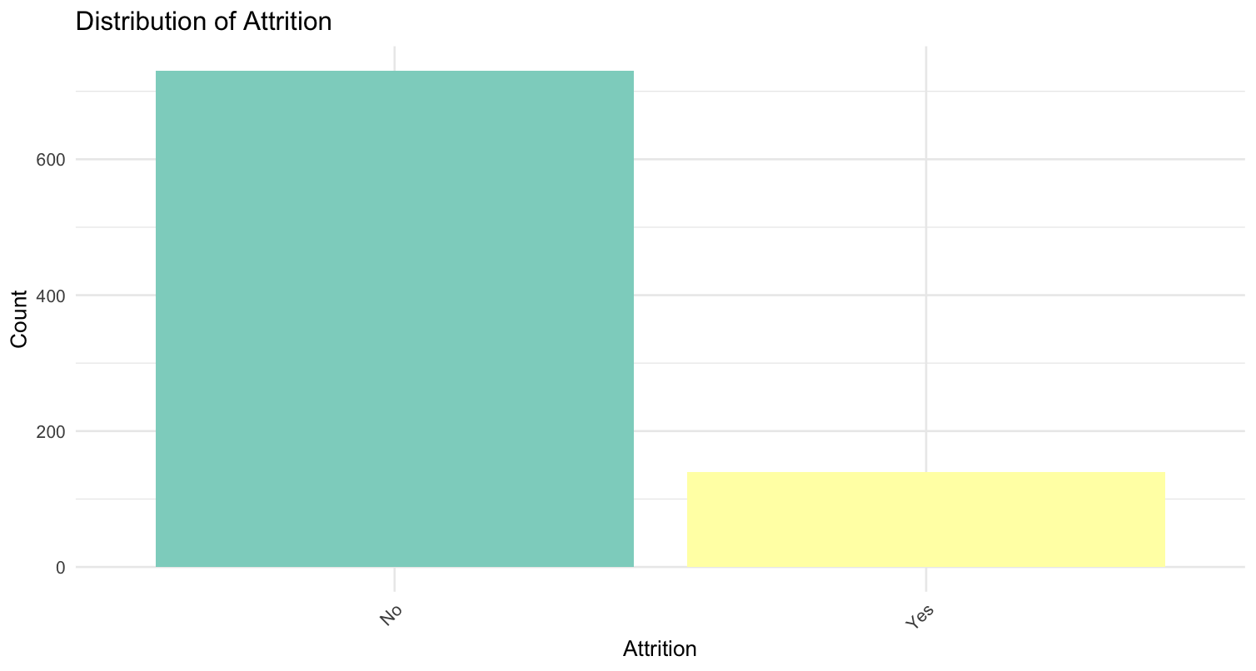

Slide 7
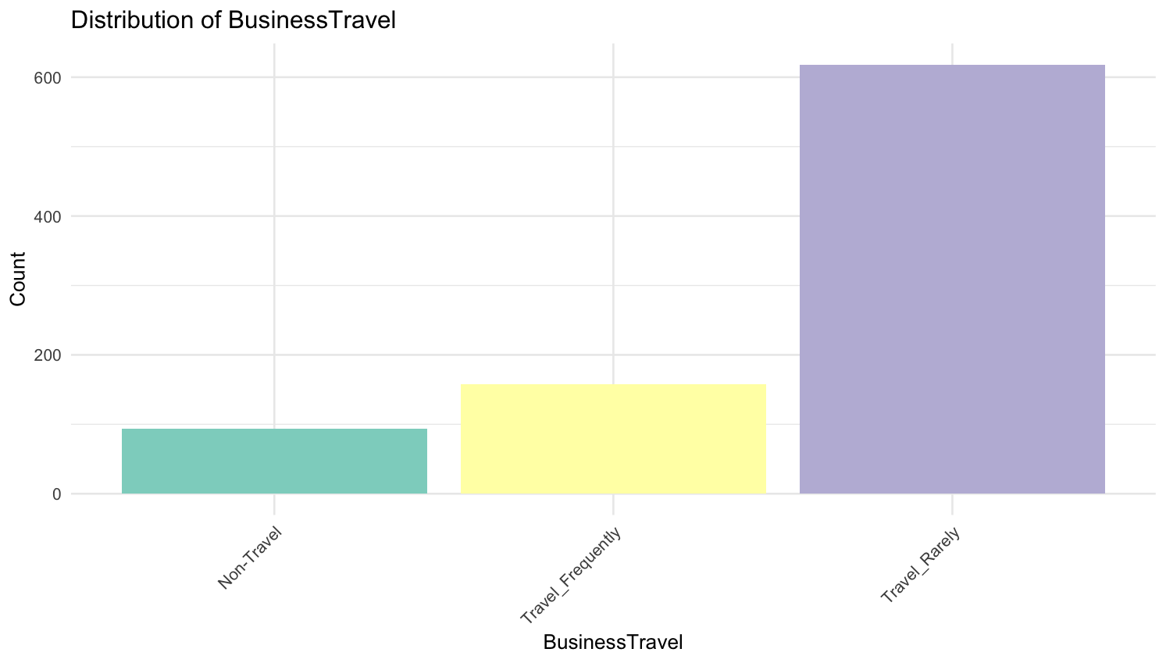

Slide 8
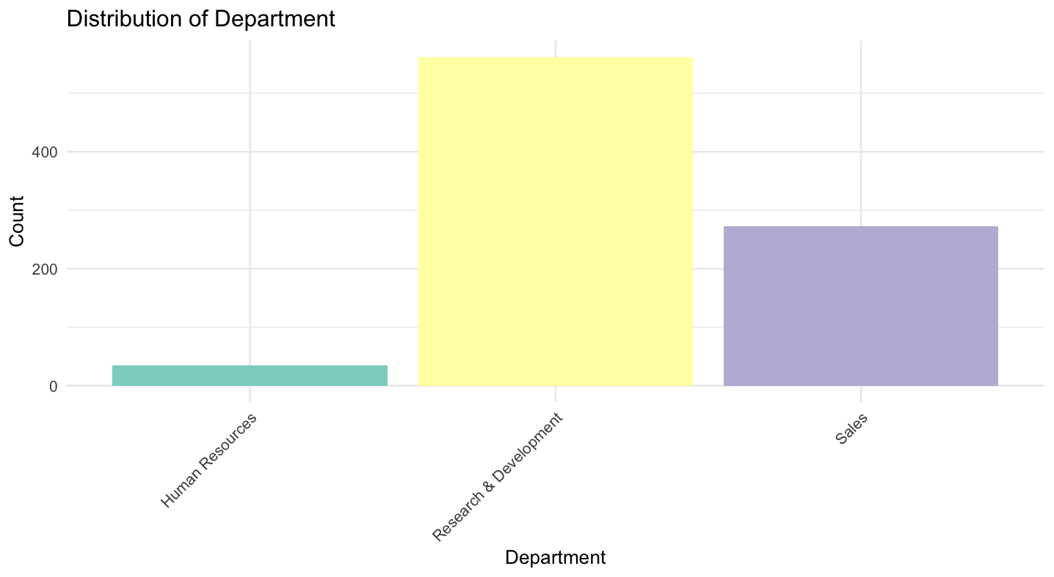

Slide 9
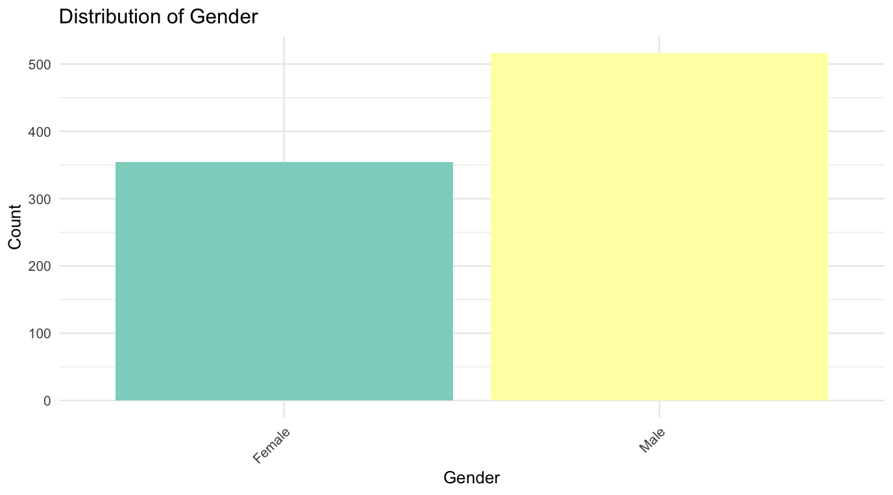

Slide 10
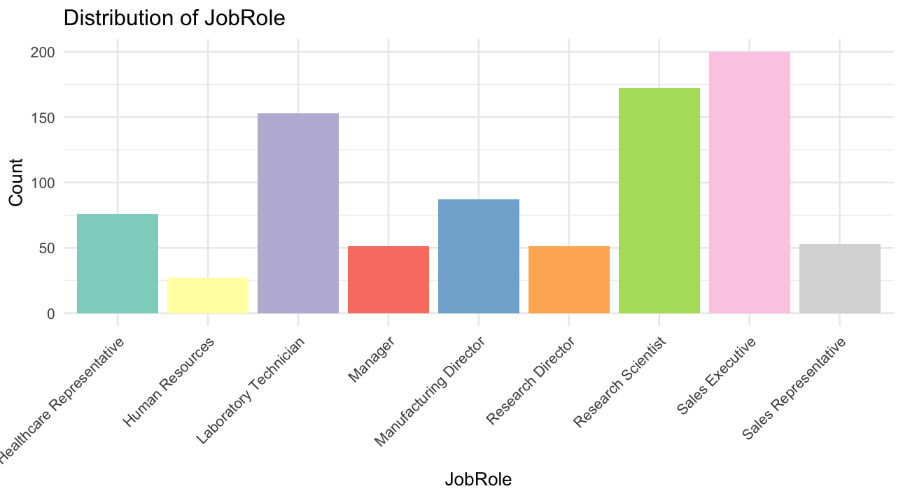

Slide 11
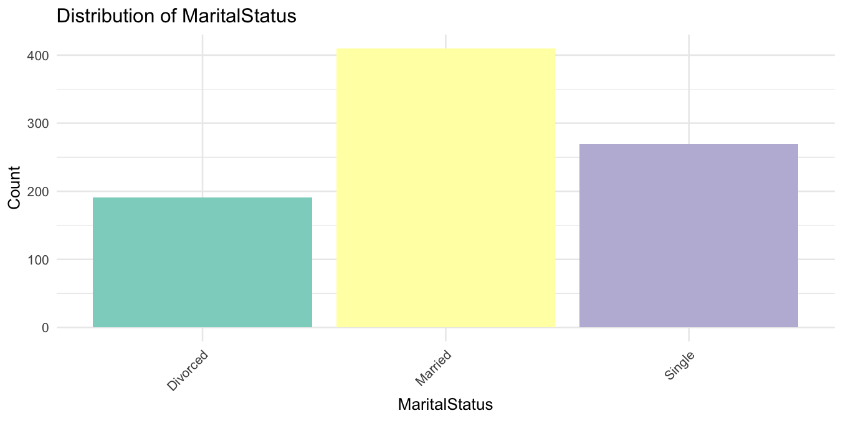

Slide 12
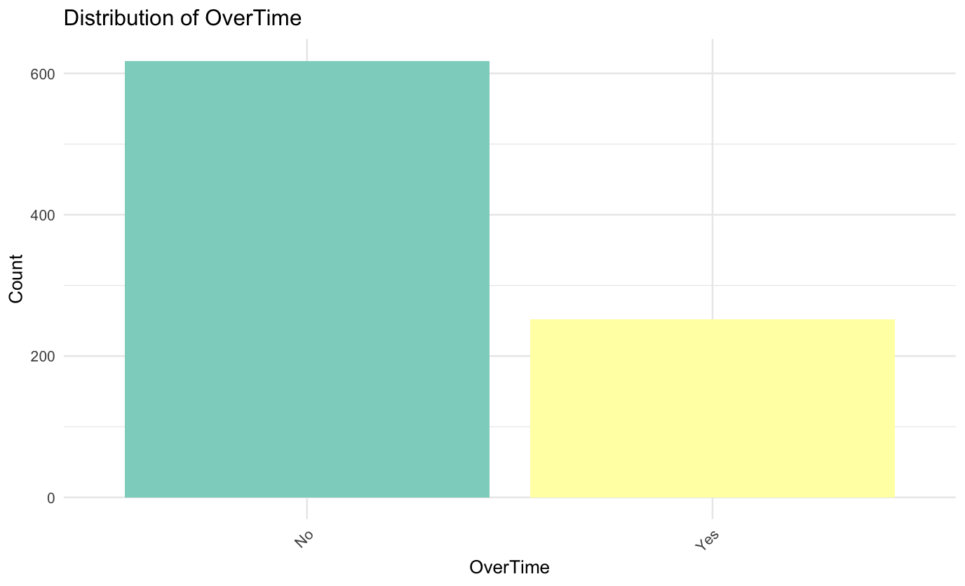

Slide 13
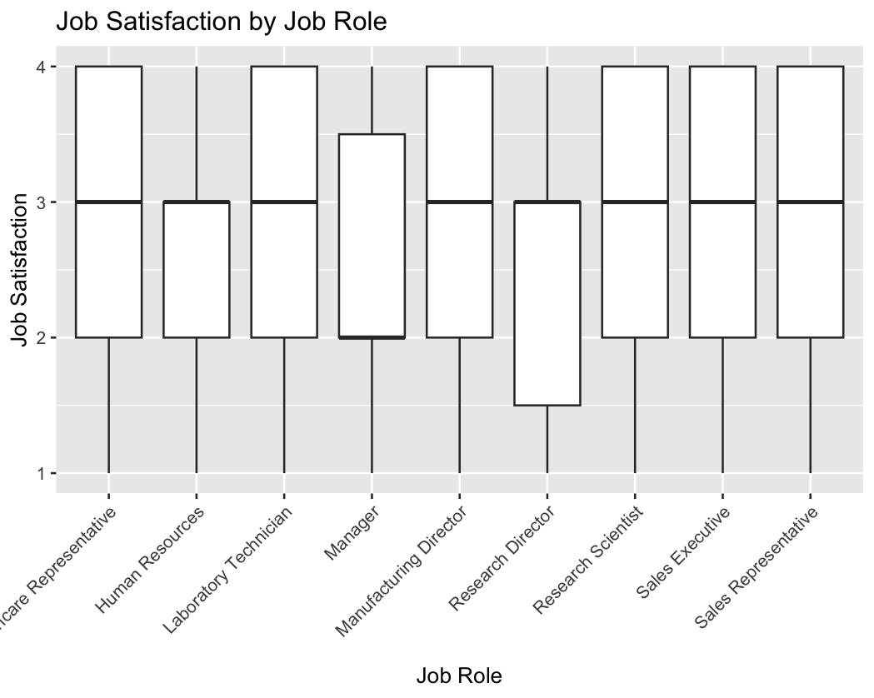
Notes:
The median job satisfaction for most job roles is around level 3, which suggests a generally high level of job satisfaction across these roles.
The range is relatively small for each job role. This indicates that job satisfaction scores are somewhat consistent among employees within the same job roles.
It appears that Laboratory Technician has a wider IQR compared to other roles, indicating more variability in job satisfaction among individuals in this position.
There are no visible outliers in this data, which means there are no job satisfaction scores that are unusually high or low outside the typical range of the rest of the data.
All roles show the bottom of the box at or above satisfaction level 2, suggesting that very low satisfaction (level 1) is less common across the board.

Slide 14
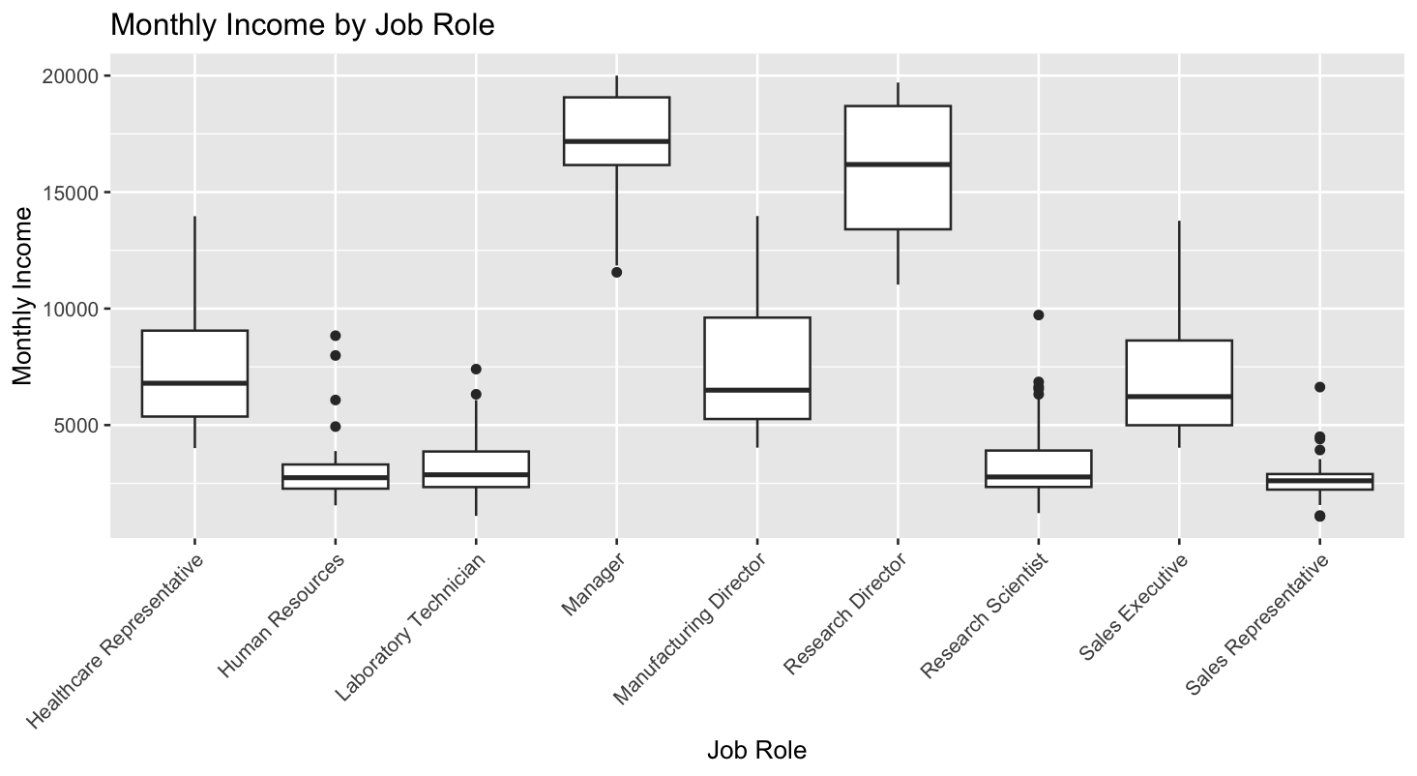
Notes:
Research Director has the highest median monthly income, as well as the largest spread in salaries within this role. There are also a few outliers indicating that there are some individuals with particularly high income in this role.
Sales Representative appears to have the lowest median income, along with a relatively smaller range, indicating less variation in the salaries for this role. Several outliers suggest that a few sales representatives earn significantly more than their peers.
Manager and Manufacturing Director roles have similar median incomes and ranges, suggesting comparable salary distributions within these job roles.
Healthcare Representative, Human Resources, and Laboratory Technician show lower median incomes compared to managerial roles and also display a number of outliers, which are individuals earning well below or above the median income
In conclusion, this boxplot indicates that job role is a significant factor in determining monthly income, with a clear hierarchy from Sales Representative to Research Director. Understanding these distributions can be important for addressing issues related to employee turnover, as compensation is often a key factor in job satisfaction and retention.

Slide 15
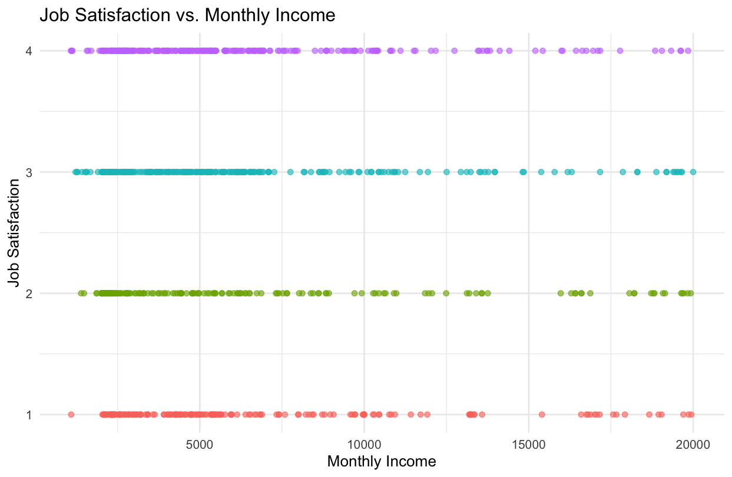
Notes:
No Clear Correlation: There does not appear to be a strong correlation between job satisfaction and monthly income. Individuals with higher salaries are seen across all levels of job satisfaction, and similarly, individuals with lower salaries also report a range of satisfaction levels from low to high.
Distribution Across Satisfaction Levels: For each level of job satisfaction, individuals are spread across a wide range of income levels. This suggests that income is not the sole determinant of job satisfaction.
Lower Income Range: At the lower income range, particularly around 5000 or below, there are many individuals with job satisfaction levels of 3 and 4, indicating that even with lower salaries, a significant number of employees report high job satisfaction.
High Income Individuals: At the higher income range, particularly above 15000, while there are fewer data points, there is still a spread across all levels of job satisfaction. This suggests that higher income does not guarantee higher job satisfaction.
Job Satisfaction Level 1: There's a notable concentration of data points at the lowest job satisfaction level (1) across the income range, indicating that irrespective of income, there's a consistent group of individuals who report being dissatisfied with their job.

Slide 16
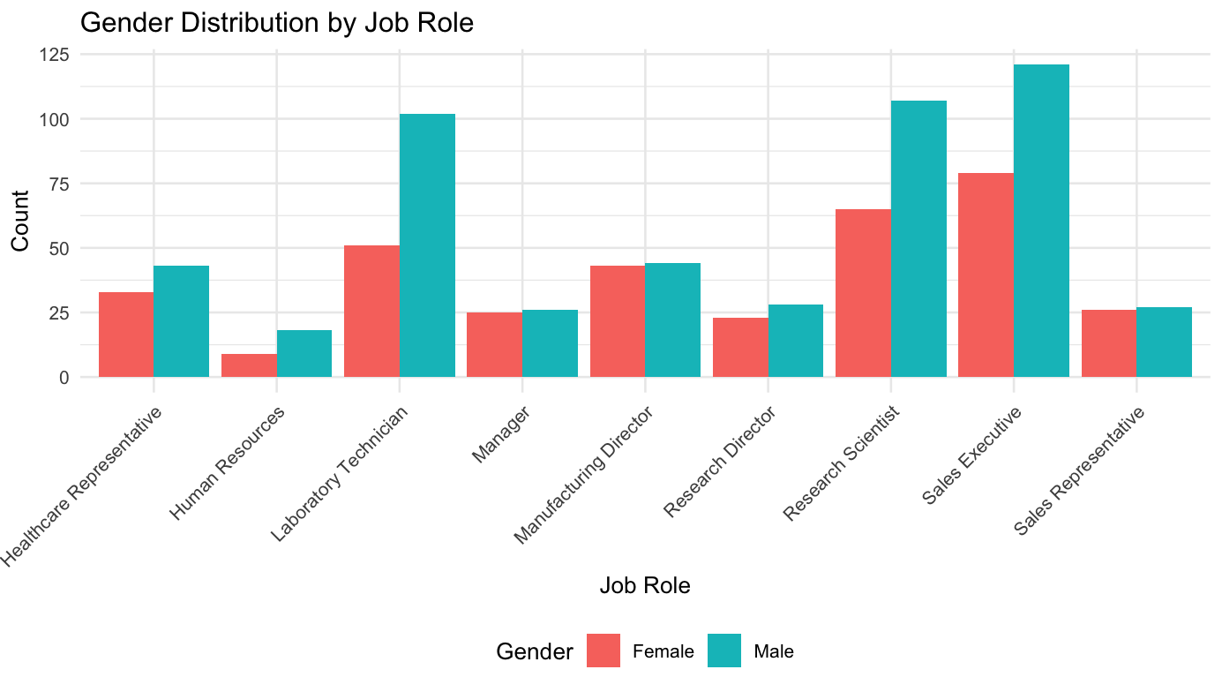
Notes:
Sales Executive: significant male favor
Research Scientist: more balanced slight male favor
Healthcare Representative and Human Resources:favors females
Laboratory Technician: favors males
Manager: relatively balanced slight male favor
Manufacturing Director: fairly even
Research Director: favors males
Sales Representative: favors males

Slide 17
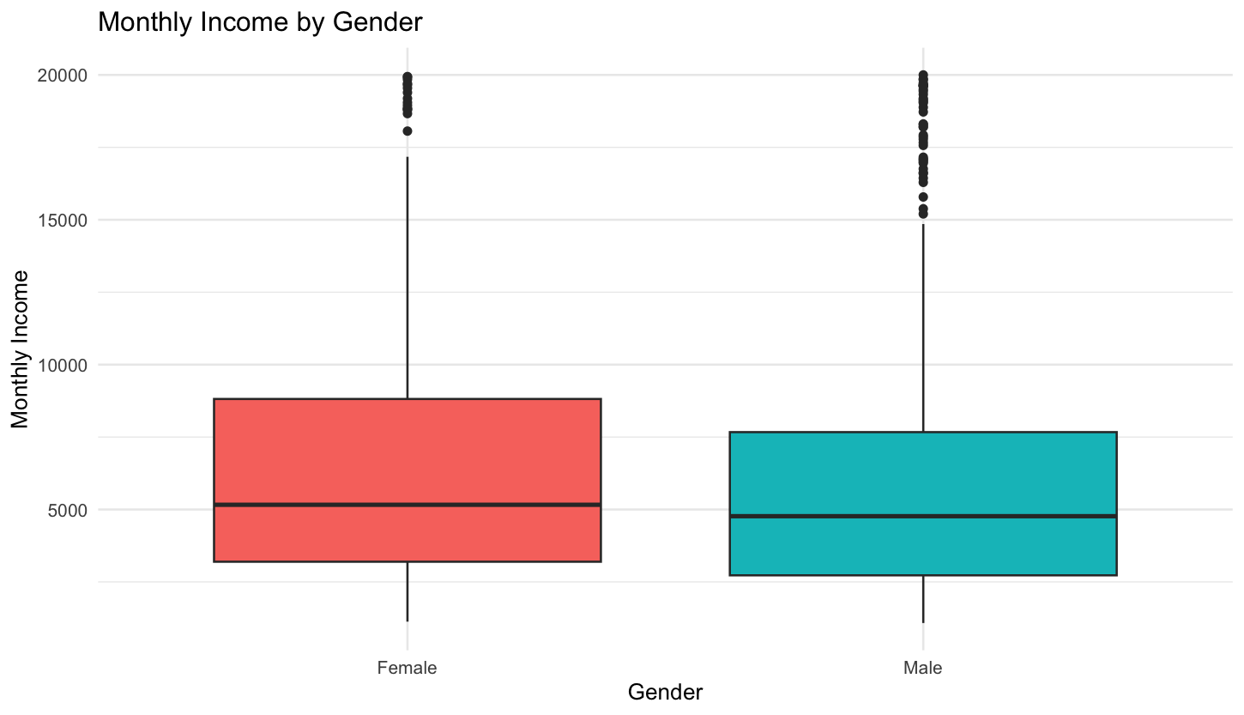
Notes:
The range in income for males is broader than for females, which suggests a greater spread of income levels among males. This could imply a wider range of roles or seniority levels among male employees.
Since the medians are close, this could indicate a degree of equality in terms of central tendency of income distribution between the genders.
In conclusion, while there's a similarity in the median monthly income between genders, the presence of more high-income outliers among males could point to a gender disparity at the higher end of the income spectrum within the company.

Slide 18
ATTRITION ANALYSIS

Slide 19
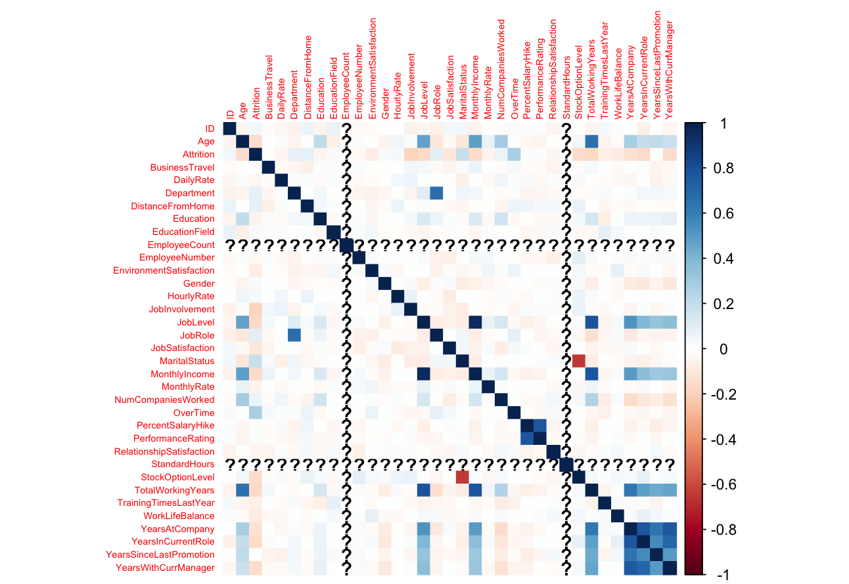

Slide 20
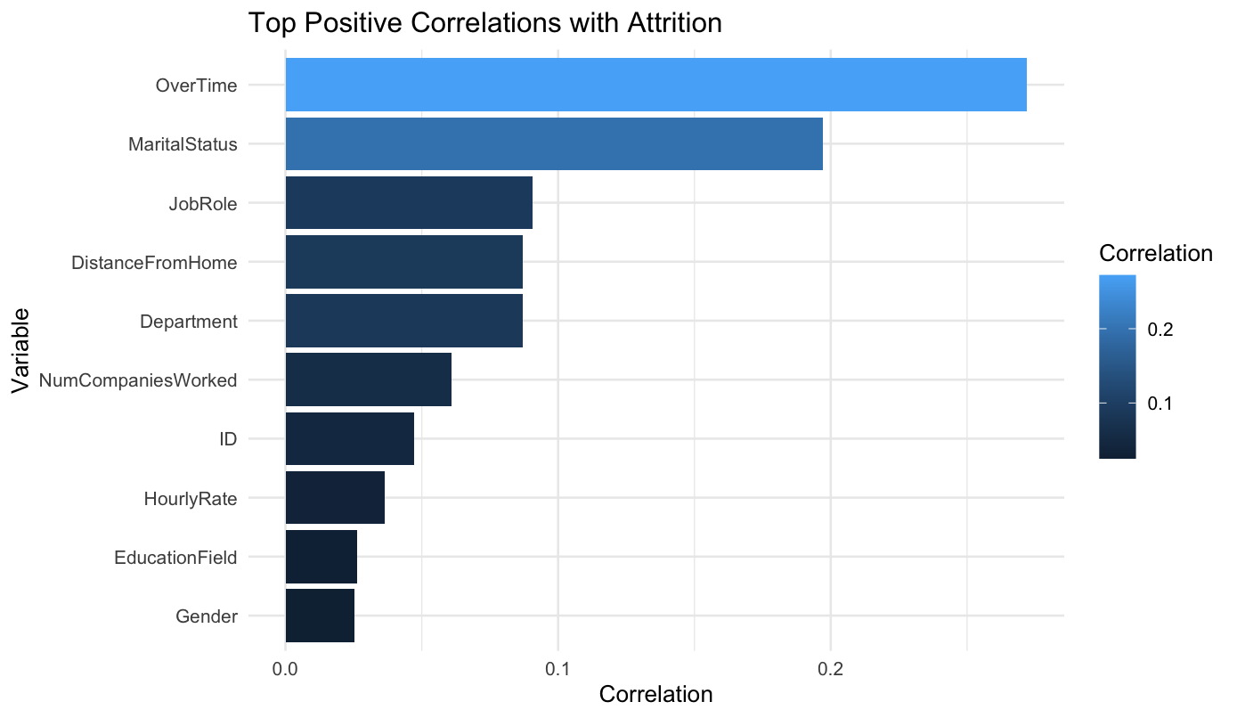
Notes:
Significant positive correlations: OverTime, DistanceFromHome, and JobRole might be strong predictors of attrition.

Slide 21
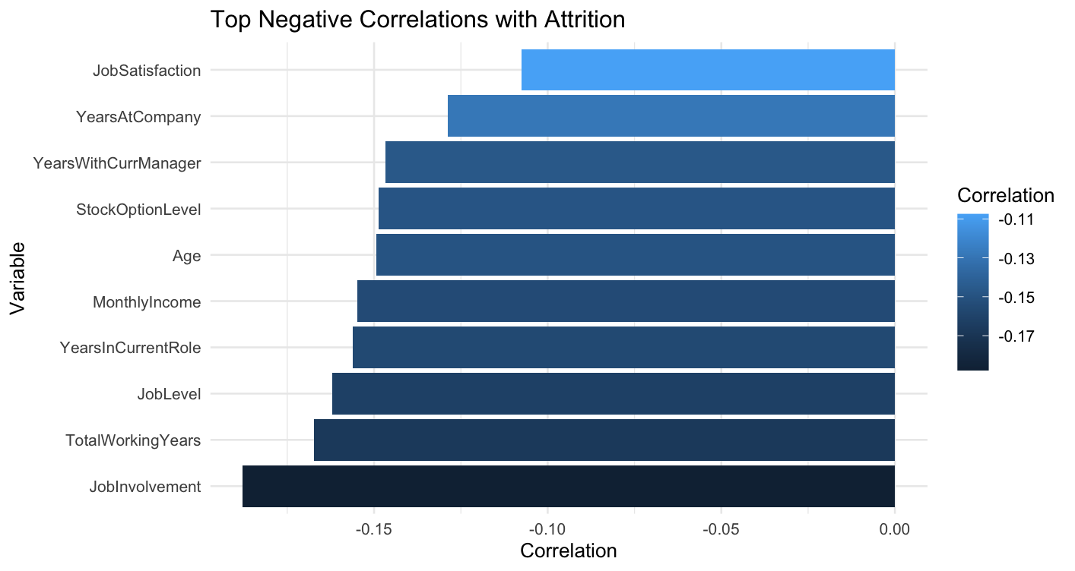
Notes:
Significant negative correlations: JobSatisfaction, EnvironmentSatisfaction, and MonthlyIncome appear to reduce the likelihood of attrition

Slide 22
CHOSEN MODEL
Attrition ~ OverTime + MaritalStatus + JobRole + DistanceFromHome + JobInvolvement + TotalWorkingYears + JobLevel + YearsInCurrentRole + Age + YearsWithCurrManager + YearsAtCompany+ JobSatisfaction + YearsSinceLastPromotion + TrainingTimesLastYear + NumCompaniesWorked + BusinessTravel + WorkLifeBalance + EnvironmentSatisfaction + RelationshipSatisfaction + HourlyRate
Notes:
Naive Bayes model has been developed to predict employee attrition, identifying which employees are likely to leave ('Yes') or stay ('No') with the company. The model uses factors like job role, marital status, work distance, and other personal and professional attributes to make its predictions.

Slide 23
CHOSEN MODEL
Overview
87% accuracy
95% CI: 81%-92%
Specific Measures
True Positive Rate (Sensitivity) 92%
True Negative Rate (Specificty) 64%
Prevalence 83%
Notes:
Accuracy: 87.36% - This is a strong overall performance, especially when considering the complexity of human behavior.
95% Confidence Interval: 81.49% to 91.9% - This range gives us a high degree of confidence that the model's accuracy is robust, as repeating this model with different samples of employees would yield a similar accuracy most of the time.
Kappa: 0.5449 - A Kappa value around 0.55 indicates a moderate agreement beyond chance, which is decent for initial modeling efforts in complex human-related predictions like attrition.
P-Value [Acc > NIR]: 0.1265 - The value suggests that while the model performs better than just guessing
Sensitivity: 91.78% - The model is highly effective at identifying employees who will stay, which means we can be quite confident in the model's predictions when it forecasts that an employee is not likely to leave.
Specificity: 64.29%

Slide 24
KEY FINDINGS
Top Factors
OverTime
DistanceFromHome
JobRole Specific Trends
Notes:
OverTime: Employees working overtime are more likely to leave.
DistanceFromHome: Longer commutes are associated with more likely to leave.
JobRole Specific Trends: Certain roles are more prone to turnover, possibly due to job satisfaction levels.

Slide 25

STRATEGIES
Review overtime policies
Consider remote work options
Target employee engagement and satisfaction especially for jobs with high turnover rates
STRATEGY N°3

Slide 26
CONCLUSION
Notes:
As a company, you want to ensure you’re proactively identifying risks of turnover to intervene appropriately. These insights help you to focus on specific areas of the employee experience that may lead to attrition and enhance your talent management strategies accordingly.

Slide 27

THANK YOU
DDS ANALYTICS
For any questions or comments please contact me at:
hernandezv@mail.smu.edu

